Slide 1
Crazy Practical
Loïc Deschwanden
Guillaume Krafft
Timothée Hirt
Jonathan Henry

Slide 2
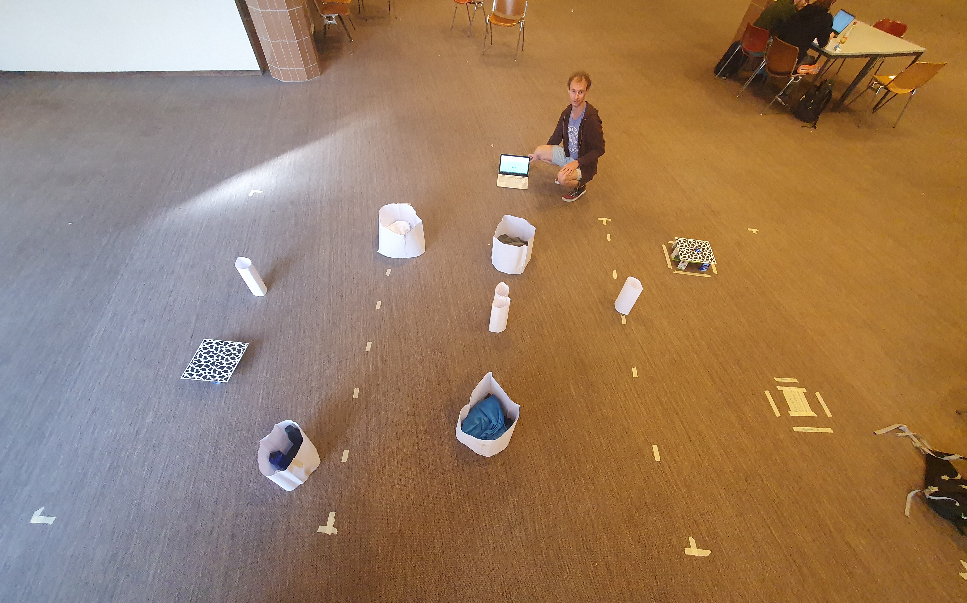

Experimental Setup
Platforms of 30 x 30 [cm]
Arena of 5 x 3 [m]
7-8 obstacles made of paper
Diameters: ~40 cm and 10 cm

Slide 3
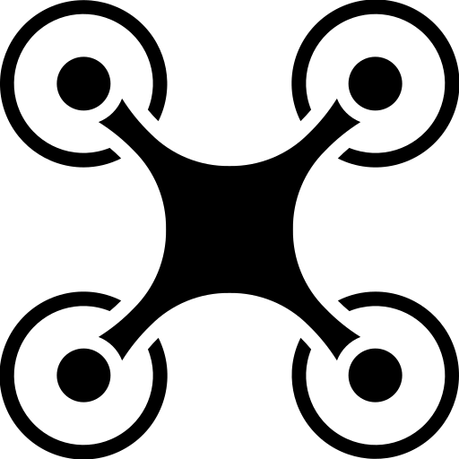



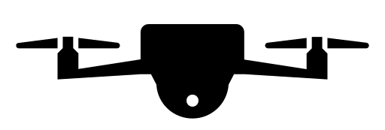
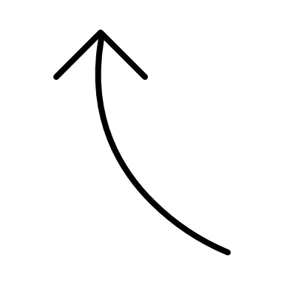
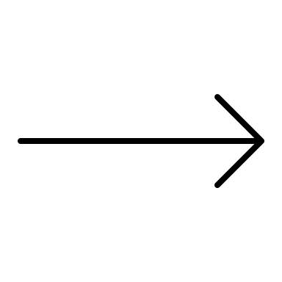
Strategy
Line following while avoiding obstacle
When landing zone reached, zig-zag
If edge detected → search other edge
Landing
Most time spent coding: landing
Landing 1
Moving
Landing 2
No yaw
Motion controller

Slide 4

Results
Mission time : between 1min15s and 2min15s
75% of success
Blind spot
Landing while diagonal flight
Weaknesses

Slide 5
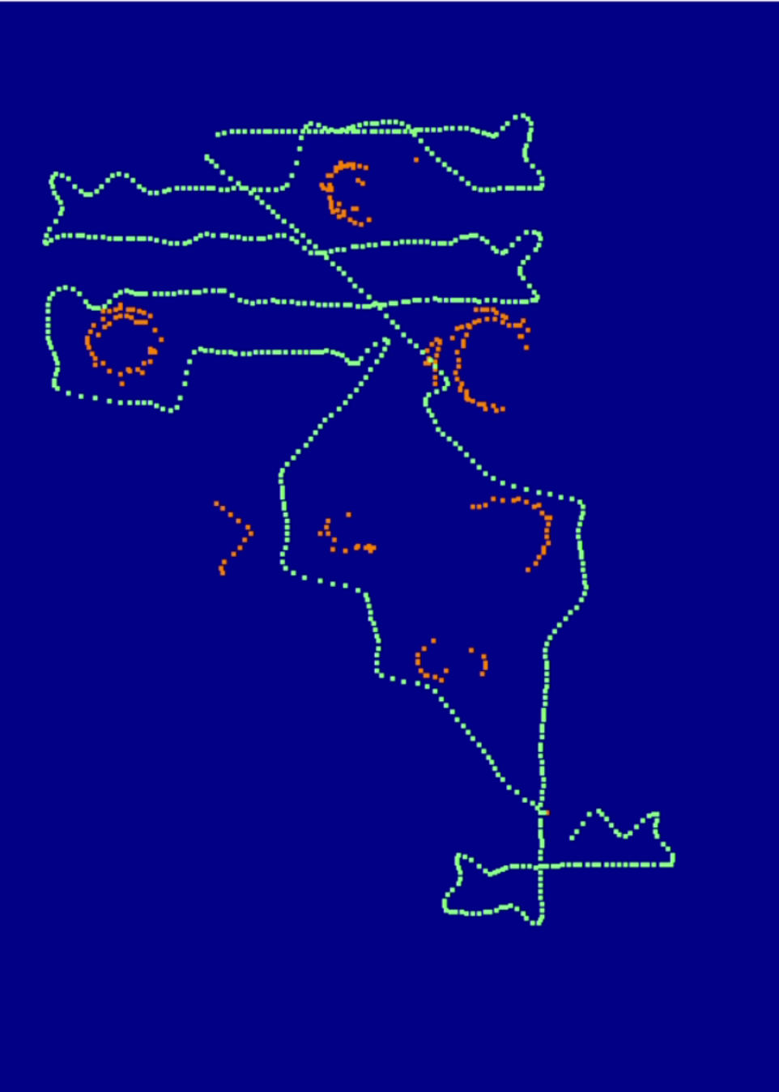
Slam
Obstacles in orange
Trajectory in green
Starting point: red square with yellow outline
Landing point: red square with green outline

